Slide 1
Creating Simple to do app
Christopher martinez

Slide 2
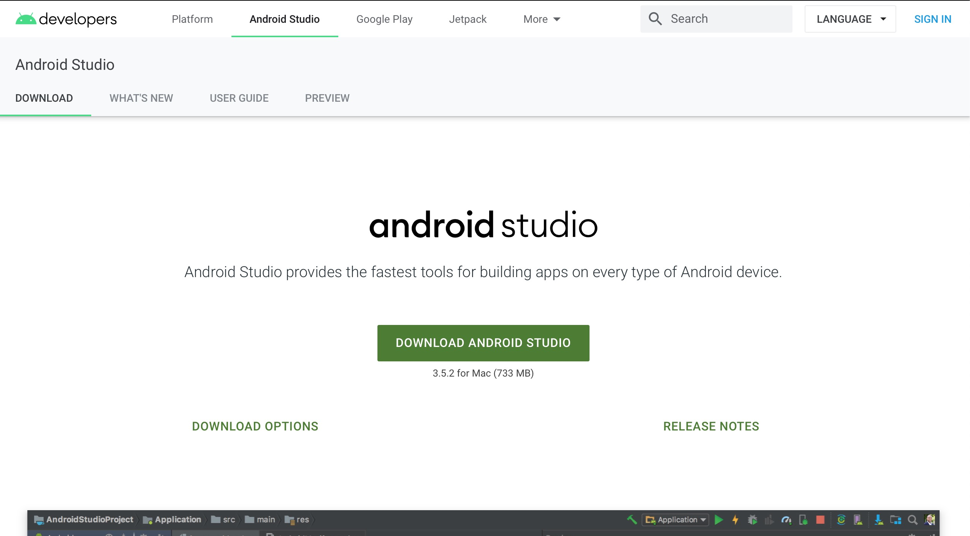
Set up Android
Software Needed:
Android studio
Git
Android emulator
Start with downloading Android Studio:
https://developer.android.com/studio

Slide 3
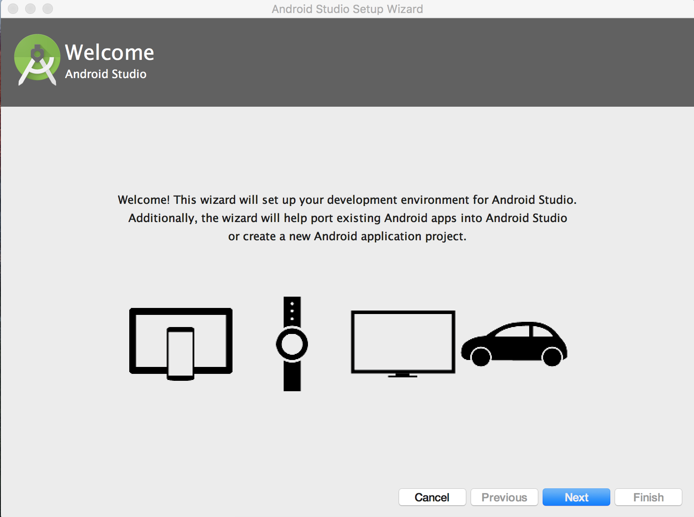
Once Android studio has installed, launch it and click: 1)Next 2)standard 3)Finish

Slide 4

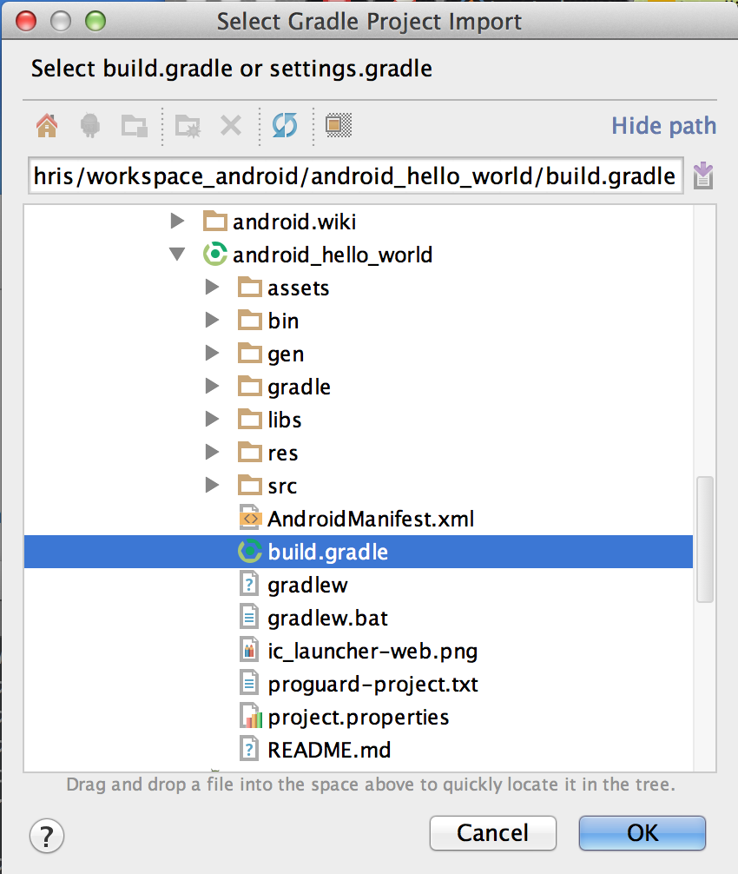
You have installed android studio, now lets use git to pull an existing project
download git command-line: https://git-scm.com/downloads
and create a github account using: https://github.com/
clone the hello world demo:
change directory to where you want your sample project using cd in the command line
run
git clone https://github.com/codepath/android_hello_world.git
now close command line and run clone in android studio:
1) switch to android studio and select open existing project...
2)now find the android_hello_world directory that you just cloned and select the build.gradle file

Slide 5
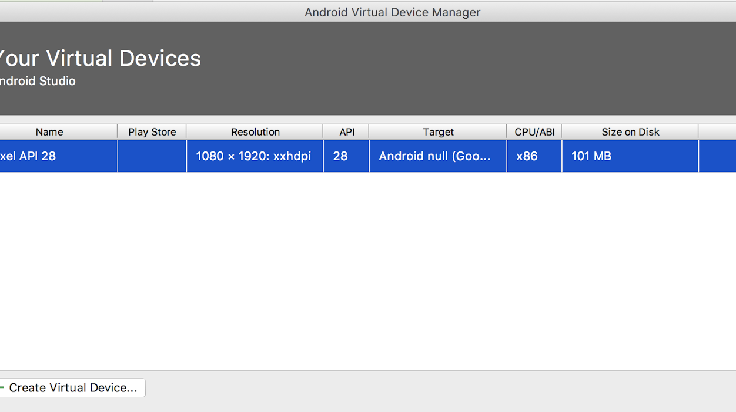
Now lets set up your emulator
Go to tools tab and click the first tab that says avd manager…
Select Create Virtual Device
Select the pixel android device
Select recommended tab and then select api 28 and finally click download link
You may leave the configuration as is and click finish

Slide 6
Now we get to start to do app
-Open android studio and click on start new project
Lets select empty activity and lets name it Simpletodo
Leave everything with default but make sure androidx. artificats Is clicked

Slide 7
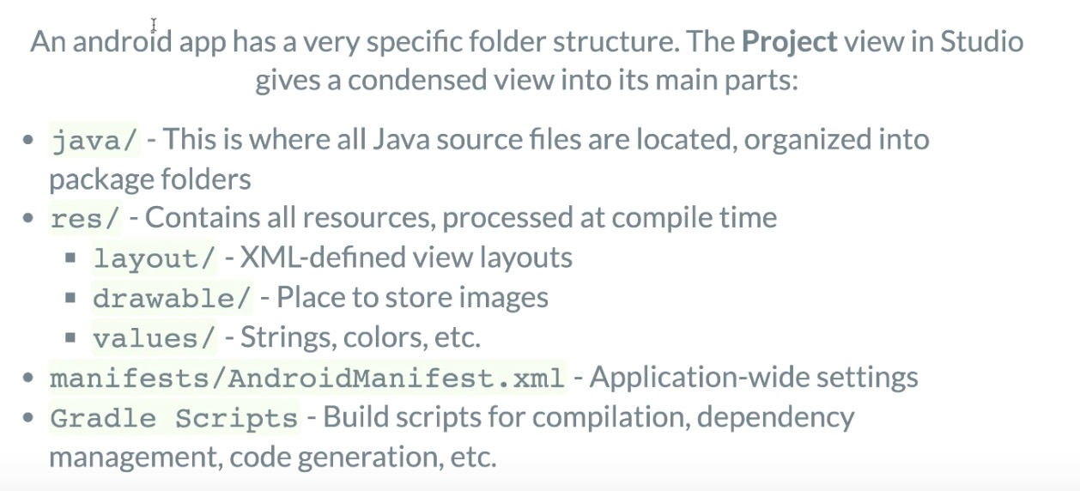
Android studio interface

Slide 8
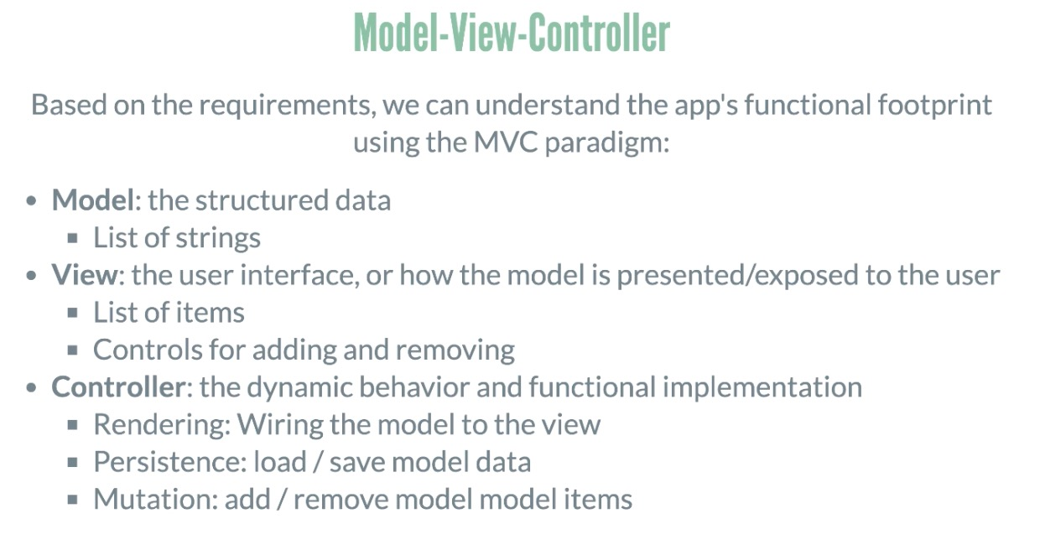
Model view controller

Slide 9
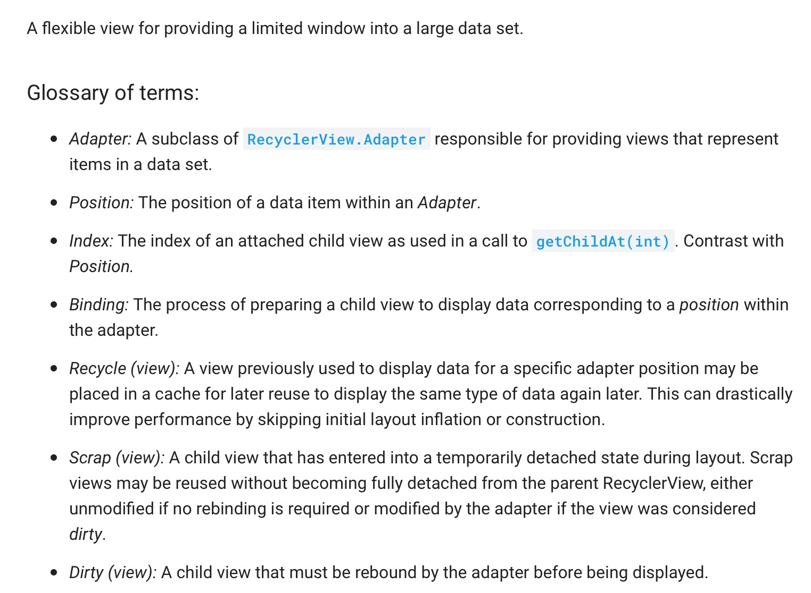
Recycler view in android studio https://guides.codepath.com/android/using-the-recyclerview

